Slide 1
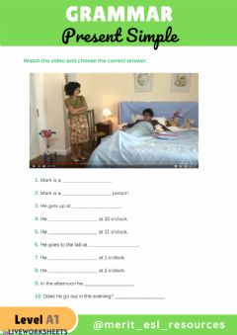
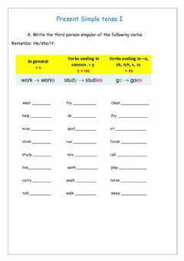
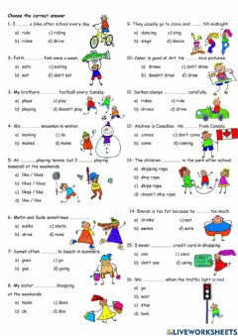
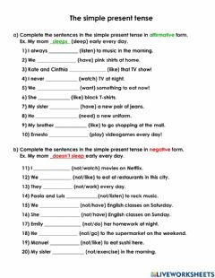
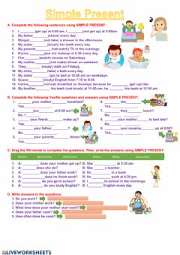
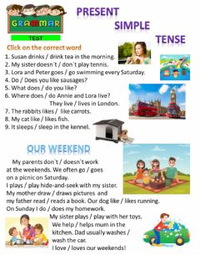
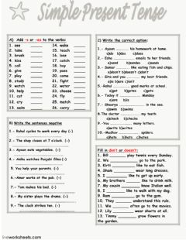
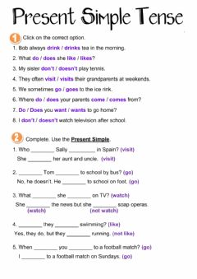
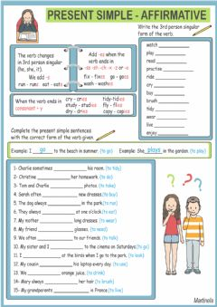
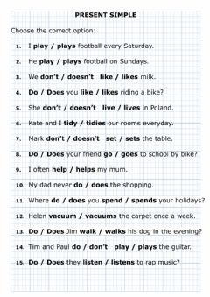



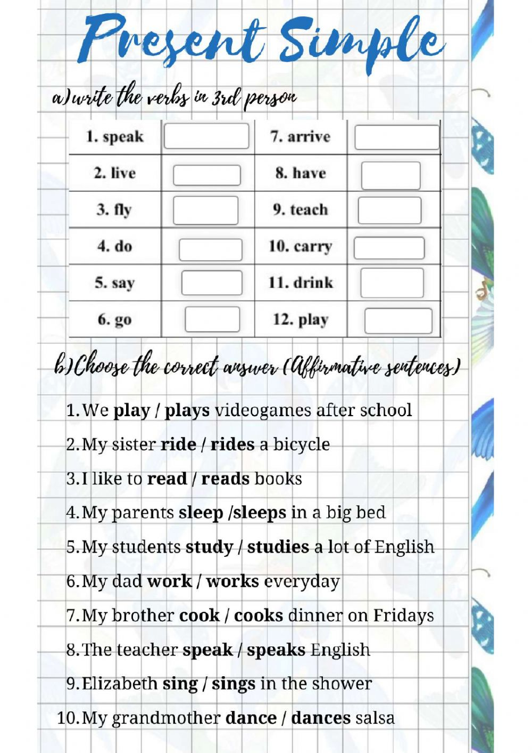
Responsive CSS
Advanced search
 | NICOLETTA1960 11/14/2021 very useful for SEN students
 | Sape300 10/26/2021 you need to write de answers of the A shupa pija
 | Zabadoo 10/18/2021 Great work but it has mistakes id d excercise- number 1 and 8.
 | FRESNILLO 10/12/2021 MISS PAULA, LE MANDO SALUDOS, POR FAVOR CORRIJA EL ESPACIO DE LOS VERBOS CONJUGADOS CON TERCERAS PERSONAS, NO TIENE RESPUESTA LA FICHA, ASI QUE LES CALIFICA INCORRECTAMENTE AL FINAL. ME GUSTA MUCHO ESTE EJERCICIO SOLO ESE DETALLE Y QUEDA PERFECTO. SALUDOS DESDE FRESNILLO,ZAC SOY MISS CLARA
 | FRESNILLO 10/6/2021 THANK YOU FOR SHARING IT! GREETINGS FROM ZACATECAS
 | ramireyes71 9/28/2021 PUTAS MAMADAS CHINGUEN A SU PUTO CULO PERRAS
 | Edra11 8/15/2021 Good worksheet but can you correct the mistakes (e.g. D1, D4, D8? I would love to use it but with the mistakes it is impossible. Nicely done otherwise.
 | NHannah 7/5/2021 BAAAAAAAAAAAAAAAAAAAAAAAAAAAAAAAAAAAAAAAAAAADDDDDDDDDDDDDDDDDDDDDDDDDD
 | Rchi 5/28/2021 Good morning. There are two mistakes on this file : questions 1 and 8. Just to tell you. Thanks. Excellent work in general.
 | Uzam 5/19/2021 It was great work sheet I like it
x
Live worksheets > English > English as a Second Language (ESL) > Present Simple > Present Simple, affirmative and negative sentences and questions
10/10
speaks
lives
flies
does
says
goes
arrives
haves
teaches
carries
drinks
playies
Present Simple by anna_misztela | Present simple affirmative by Martinela | Present Simple Tense by jecika
Present simple affirmative and negative by ilditoth | Present Simple Tense by desssii | Simple Present Exercises by Abie28
The simple present tense (affirmative and negative form) by ArelyL13 | Simple Present Tense test-2 by mdegerli | Present Simple tense I - third person singular by Sonia_Dias
Emma's daily routine - reading by mada_1 | Present Simple - Video by MeritESLResources
More Present Simple interactive worksheets
Latest comments
Terms of use Privacy policy Cookies configuration Report copyright infringement Contact
Teachers access
Username or email: Password: Remember me
Register
Forgot my password
Present Simple, affirmative and negative sentences and questions Selecciona la respuesta correcta
ID: 1253224 Language: English School subject: English as a Second Language (ESL) Grade/level: PRIMARIA Age: 7-8 Main content: Present Simple Other contents: 3RD PERSON | Add to my workbooks (8621) Download file pdf Embed in my website or blog Add to Google Classroom Add to Microsoft Teams Share through Whatsapp | Link to this worksheet: Copy | miss_Paula_
Make interactive worksheets
Tutorial
Video tutorial
Get started
Make interactive workbooks
Video tutorial
Home
About this site
Interactive worksheets
Help
Students access
English - Español
Full stack

Slide 2

Responsive design
This Photo by Unknown Author is licensed under CC BY

Slide 3

To make web pages responsive we use “break poitns”
@media only screen and (max-width: 600px) { body { background-color: lightblue; } }

Slide 4
Make “breaking points” in order
@media only screen and (max-width: 1200px) { body { background-color: lightblue; } }
@media only screen and (max-width: 800px) { body { background-color: green; } }
@media only screen and (max-width: 600px) { body { background-color: red; } }

Slide 5
Different “breaking points” for screens
/* Extra small devices (phones, 600px and down) */ @media only screen and (max-width: 600px) {...} /* Small devices (portrait tablets and large phones, 600px and up) */ @media only screen and (max-width: 768px) {...} /* Medium devices (landscape tablets, 768px and up) */ @media only screen and (max-width: 992px) {...} /* Large devices (laptops/desktops, 992px and up) */ @media only screen and (max-width: 1200px) {...} /* Extra large devices (large laptops and desktops, 1200px and up) */ @media only screen and (min-width: 1200px) {...}

Slide 6

Examples

Slide 7

Advance layouts

Slide 8
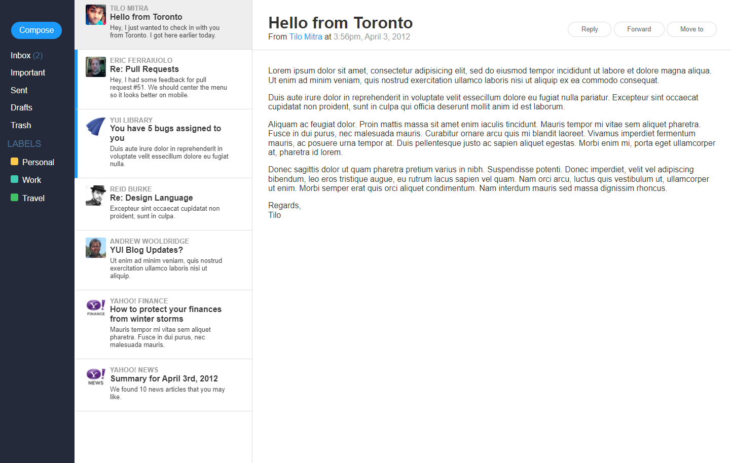

Slide 9
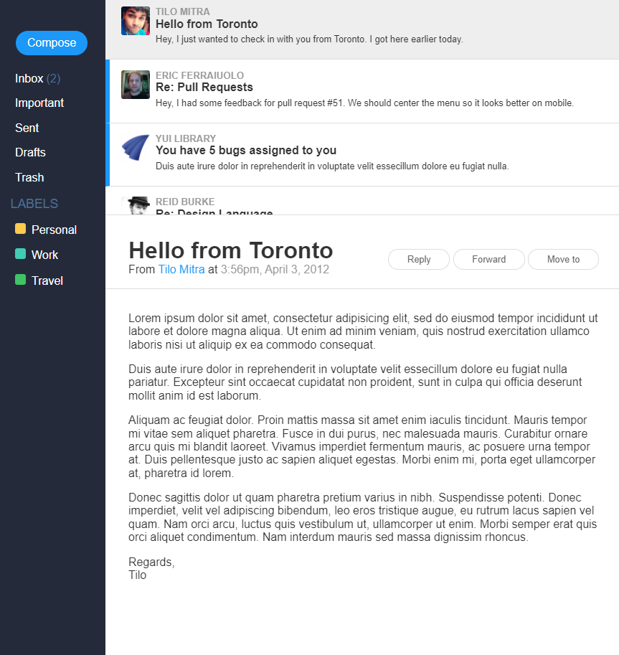

Slide 10
